Slide 1
prototyping
An introduction to
Abby larner

Slide 2
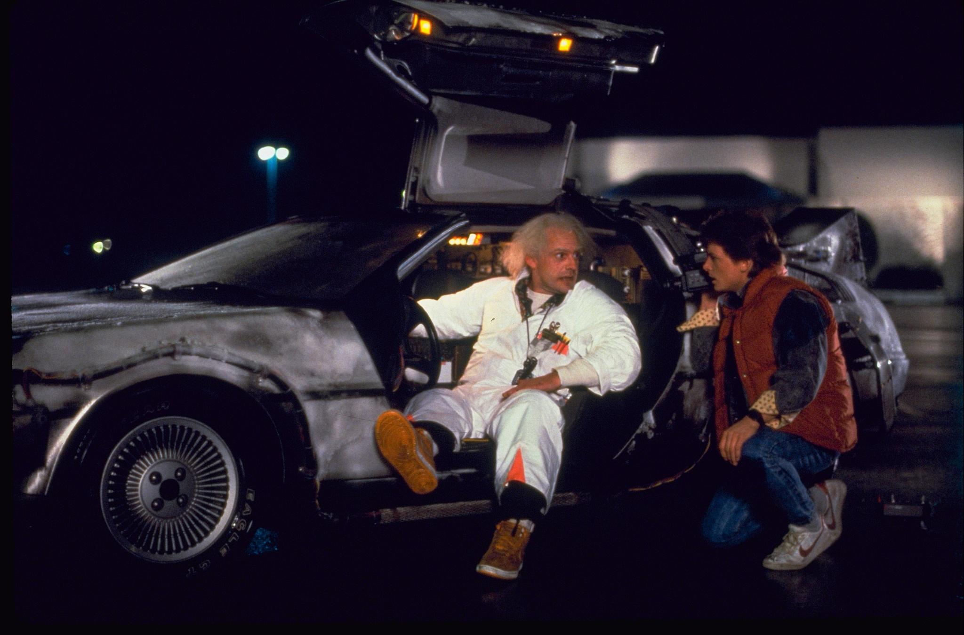

Slide 3
THE MARSHMALLOW CHALLENGE
You have 18 minutes to build a freestanding
structure from:
20 pieces of spaghetti
1 yard of tape
1 yard of string
1 marshmallow (must be on top)
Notes:
Middle school I’m sure most of you ran into a challenge like this
Tom Wujec (a fellow who studies collaborative creativity, problem solving, and the impact of emerging technologies on how we design and make things) conducted this experiment on 70 groups

Slide 4

MOST GROUPS:
ORIENT
PLAN
BUILD
TA-DA!
Oh No!
BUSINESS STUDENT GROUP
KINDERGARTEN GROUP
Notes:
What he found:
Most groups went through this process
Business students were the worst (based on tower height) because they are taught to solve for 1 right answer
Kindergarteners were some of the best because they played with a few options before they reached their final structure
The kindergarten method is the basis for iterative design

Slide 5
What is a prototype?
A prototype is a quasi-realistic representation of what you are building that can be interacted with and tested on users in order to help validate your design.

Slide 6
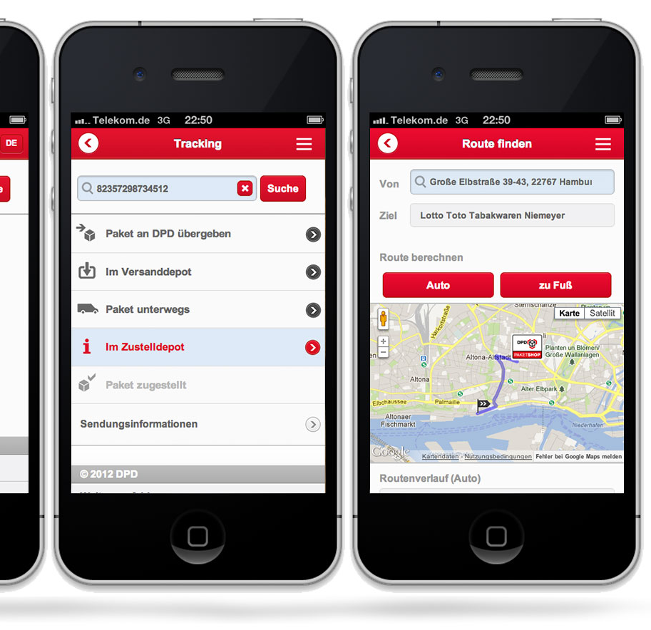
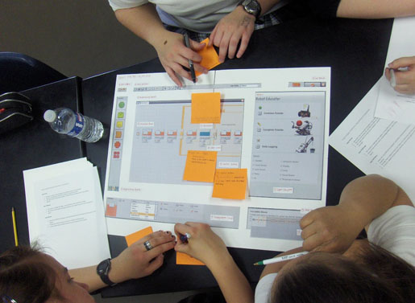
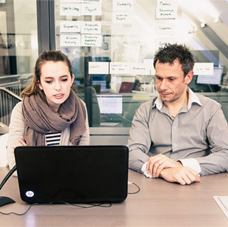
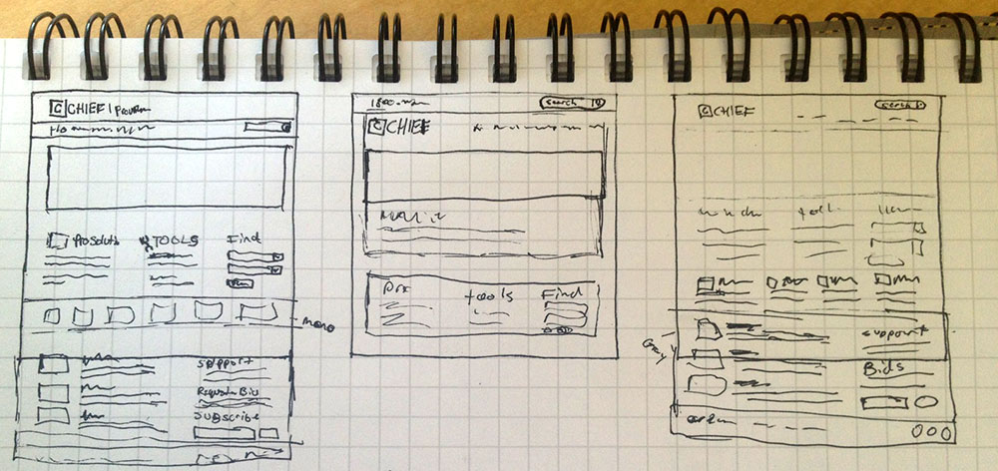
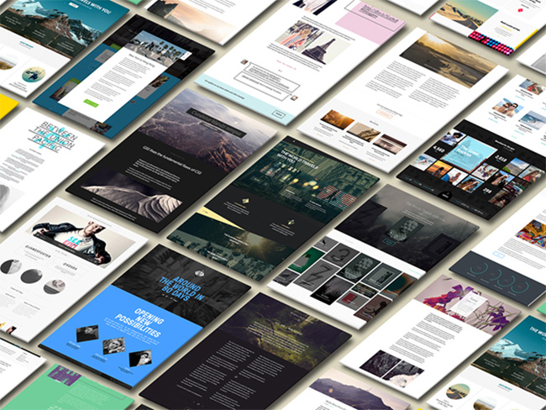
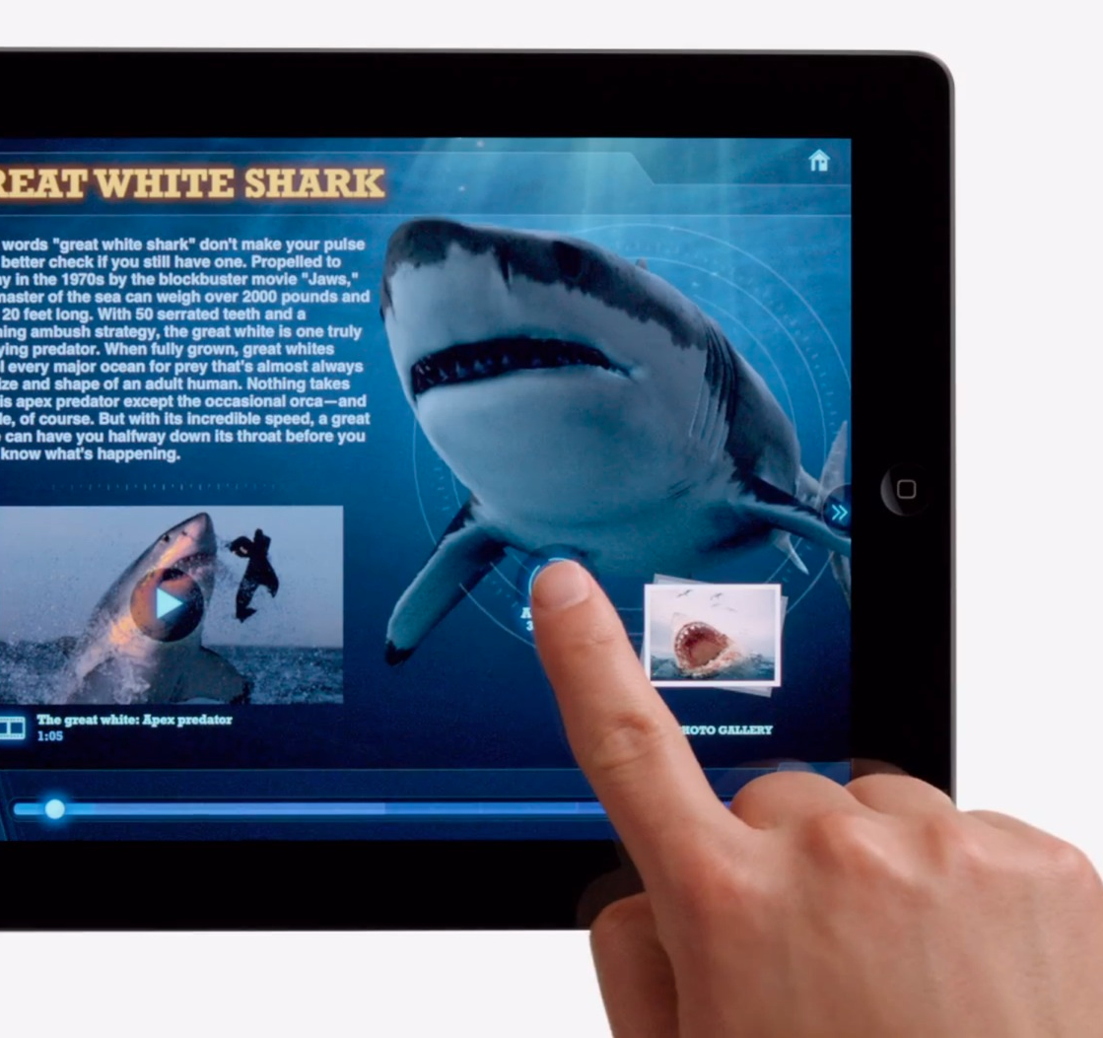
WHY DO WE PROTOTYPE?
Notes:
- To Explore potential options to solve problems
- To Refine our designs to optimize for the best user experience
- Observe how users want to interact with your design
- To work out complex functionality or screen flows
- To help begin to define the interaction design
- Faster to create than fully functional solutions

Slide 7

Notes:
- Google has been trying to solve an interesting problem for the past few years. How do we allow people to interact with eachother and technology at the same time?
They wanted to create a product that allowed people to use technology without removing themselves from the world around them
Decided to prototype a “heads up display”
Frist question they needed to answer – is it possible?
How long did it take to produce the first prototype? 1 day – Plexiglass, hangar, sheet protect, and projector
Second prototype – 45 min – what would the experience be like/ how can we make it happen? The minority report – 45 minutes – Used hair ties, fishing wire, and remotes to move right/left
Prototyping is MacGyvering, having a very basic/unrefined prototype can tell you a lot about your product without having to spend lots of time/money

Slide 8
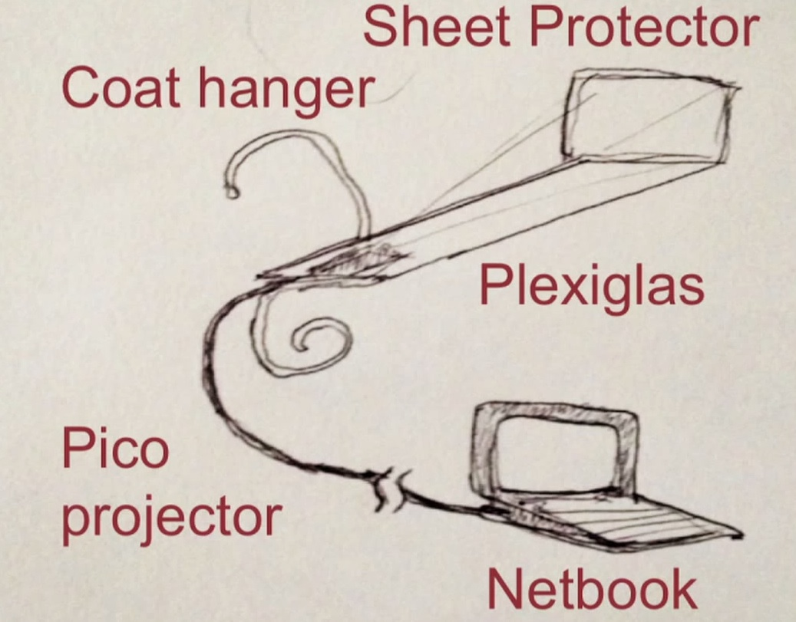
Notes:
- Google has been trying to solve an interesting problem for the past few years. How do we allow people to interact with eachother and technology at the same time?
They wanted to create a product that allowed people to use technology without removing themselves from the world around them
Decided to prototype a “heads up display”
Frist question they needed to answer – is it possible?
How long did it take to produce the first prototype? 1 day – Plexiglass, hangar, sheet protect, and projector
Second prototype – 45 min – what would the experience be like/ how can we make it happen? The minority report – 45 minutes – Used hair ties, fishing wire, and remotes to move right/left
Prototyping is MacGyvering, having a very basic/unrefined prototype can tell you a lot about your product without having to spend lots of time/money

Slide 9
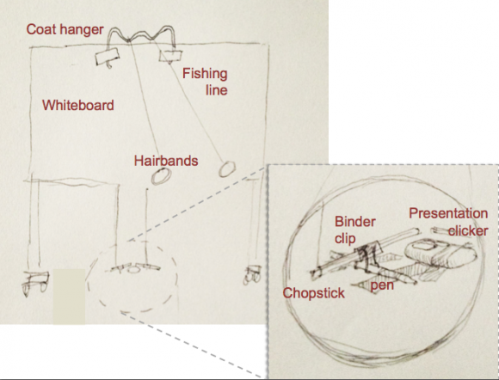
Notes:
- Google has been trying to solve an interesting problem for the past few years. How do we allow people to interact with eachother and technology at the same time?
They wanted to create a product that allowed people to use technology without removing themselves from the world around them
Decided to prototype a “heads up display”
Frist question they needed to answer – is it possible?
How long did it take to produce the first prototype? 1 day – Plexiglass, hangar, sheet protect, and projector
Second prototype – 45 min – what would the experience be like/ how can we make it happen? The minority report – 45 minutes – Used hair ties, fishing wire, and remotes to move right/left
Prototyping is MacGyvering, having a very basic/unrefined prototype can tell you a lot about your product without having to spend lots of time/money

Slide 10
Functional Prototype
Paper – Mockup/
Photo Gallery
Static HTML
Clickable/Tappable
Visual Fidelity
Paper - Wireframe
Paper - Sketch
Concierge
Functional Fidelity

Slide 11
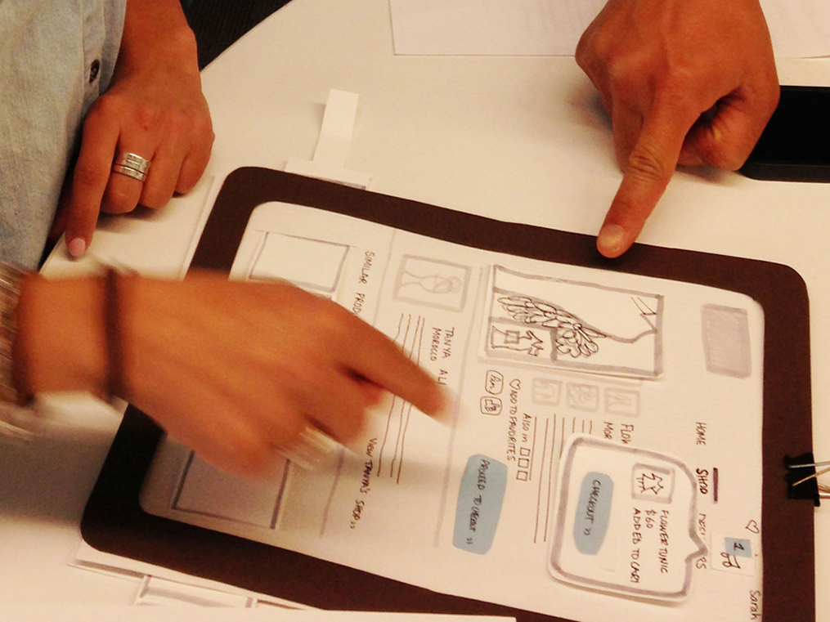
Paper prototypes
Notes:
ADVANTAGES:
Fast Iterations
Cheap
Doesn’t require knowledge of any programs
You’re not limited by the capabilities of a program
DISADVANTAGES:
Some concepts are difficult to demonstrate
Concepts difficult to represent:
Page loading time
Refresh
Horizontal/Vertical scrolling
With sketches you can’t represent colors or fonts (need a printout)

Slide 12
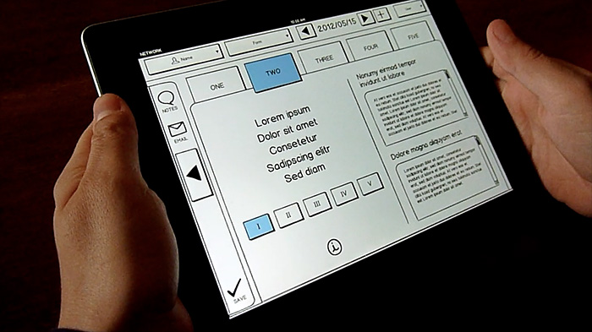
Clickable/Tappable prototypes
Notes:
ADVANTAGES:
Fast Iterations
Lots of resources out there to make these effectively
Balsamiq
Axure
Omnigraffle
Marvel
Doesn’t require knowledge of any programs
You’re not limited by the capabilities of a program
DISADVANTAGES:
More time consuming
Learning curve with certain applications
Cost
Have to use built in styles

Slide 13
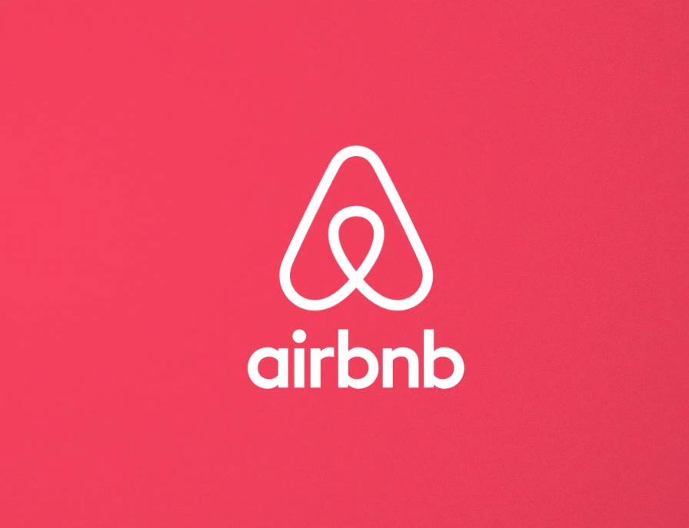
Notes:
Airbnb
Trying to make renting a place while traveling more affordable and personal (craigslist was too impersonal)
Brian Chesky and Joe Gebbia Couldn’t afford rent in their SF apartment
Big design conference coming up and not enough space for participants so they rented out 3 air mattresses for $80 each in their apartment
ADVANTAGES:
Learn exactly what your users need and how they will interact with it
Cheap
You’re not limited by the capabilities of a program/code
DISADVANTAGES:
Very hands on/time consuming
Can’t test interactions very well

Slide 14
Prototyping Tips

Slide 15
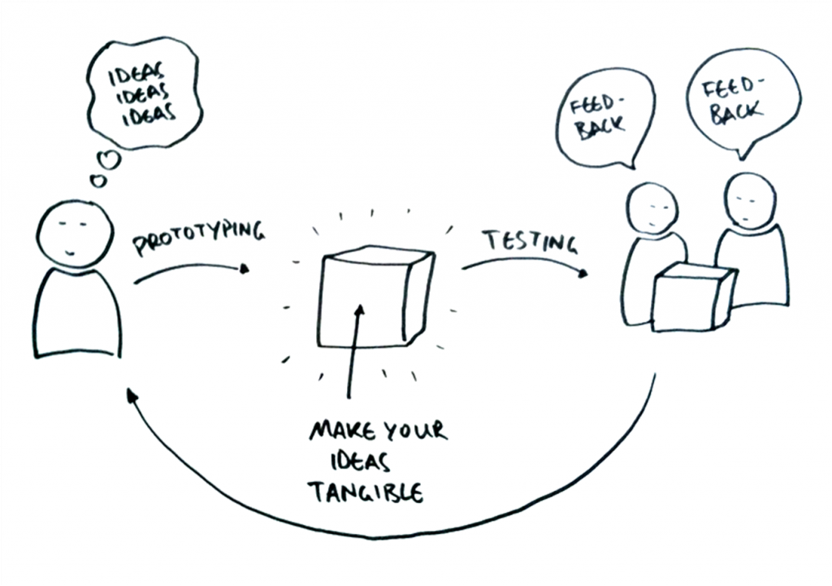
Notes:
Prototyping is an on-going process and can be done with both hardware and software
It can be done on things as high level as an entire product, or as low level as one interaction (for example the design of a navigation)

Slide 16

Notes:
Understand what you want to learn from a prototype before you build it
Understanding the goals of the prototype is important so you come out with concrete answers to questions you have about your product (can be high level or very specific), it can also inform which type of prototype is best for your testing
Maximize learning, minimize effort

Slide 17
resources
Hack Design Toolkit
Prototypes – The Beginner’s Guide
Paper Prototyping
How to create a website prototype
Prototyping Google Glass
Build a Team, Build a Tower – Tom Wujec
UX Tools
Make me a prototype
Design Better and Faster with Rapid Prototyping
Airbnb: The Growth Story You Didn’t Know
Proto Talk
Prototyping for Better Products, Stronger Teams, and Happier Clients
Notes:
Prototyping happens at all stages of product development
Understanding the goals of the prototype is important so you come out with concrete answers to questions you have about your product (can be high level or very specific), it can also inform which type of prototype is best for your testing
What is the minimum amount of time you can put into a prototype in order to get the best quality and quantity of answers?

Slide 18
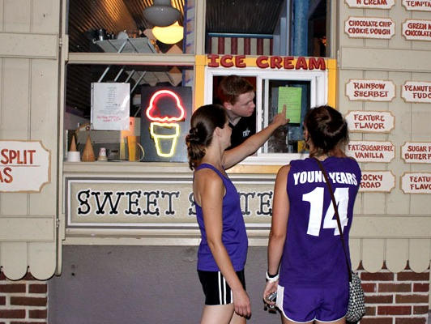

Slide 19
Activity
The Perfect Scoop is a walk up ice cream shop that gets very busy with the heat of the summer. The lines have started wrapping around the block, and their customers are getting frustrated with the long wait. Harry, Larry, and Gary are the three ice cream scoopers that service The Perfect Scoop, and they are the fastest scoopers in town. The problem is that they have to take orders in between scooping which slows them down and causes the line to get longer.

Slide 20
You will work in pairs to create a paper prototype of a tablet app that allows customers to input their orders so they can hang out at the nearby park while Harry, Larry, and Gary are speedily scooping. The app should be able to do the following things:
Allow the customer to choose from the 3 daily ice cream flavors
Add toppings (as many toppings as they like), and the options are sprinkles, fudge, and chocolate chips
Or allow the customer to order the “Split Decision”, The Perfect Scoop’s specialty sundae
Add multiple items to an order
Calculate and display the total of the order
Submit their order (this should include an alert to confirm their submission)

Slide 21
You will create a paper prototype of this app to test your design. This will include:
Brainstorming possibilities for how to solve this problem
Quickly sketching the UI for your design
Constructing a paper prototype that can be used to test your design (remember, you will need to make separate pieces for each time your user completes a phase of the order process)
Test your design on another group by having them act as the “customer” and you and your partner act as the “computer” taking note of problems they run into/items that you learn from the test

